Slide 1
Basic Internship@Clevered AI App/ Project Name
App User Manual
Author: Angadpartap singh virk

Slide 2
Table of Contents
Acknowledgements
About Me
About My Internship with Clevered
About App
How do I use the App?
Option Name
Contact person

Slide 3
Acknowledgements
A small vote of thanks for all who have helped you in this journey of App Development – your parents, Mr Ken, Clevered, Mentors, Group Members, Friends, Sites etc.

Slide 4
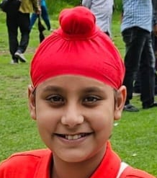
About Me..
My name is Angadpartap singh virk
My age is 10 years
And I have made the english teaching chatbot

Slide 5
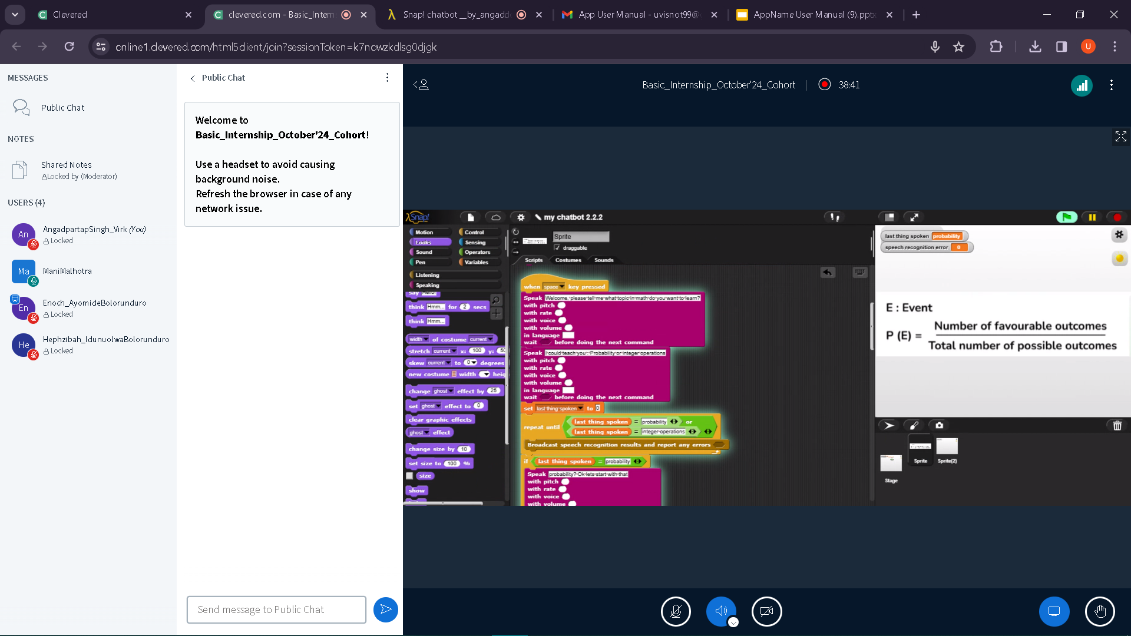
About My Internship with Clevered..
My experience with clever and mani mam was very nice. Mani mam was ready to helps no matter what the time.

Slide 6
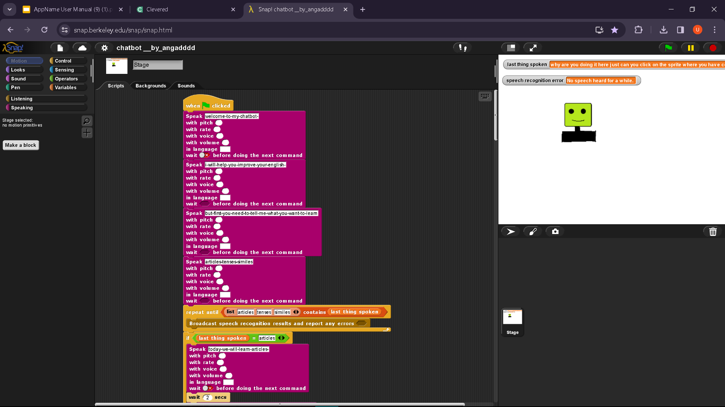
About App..
This app is based on teaching three grammar topics of english
And they are simile,tenses,articles

Slide 7
How do I use the App?
To use the app It will ask you that which topic you want to learn today articles,tenses,or simile which ever topic you will tell it to learn it will start teaching.

Slide 8
Option Name
(This will be repeated for each option of the App)
Screenshot/ Pic of each option/screen of the App
Steps to use the same
Any special considerations/ dependencies/risks while using the option

Slide 9
Contact Person
If you are concerned regarding anything please contact on - virkangad393@gmail.com

Slide 10
Thank you!

